Slide 1
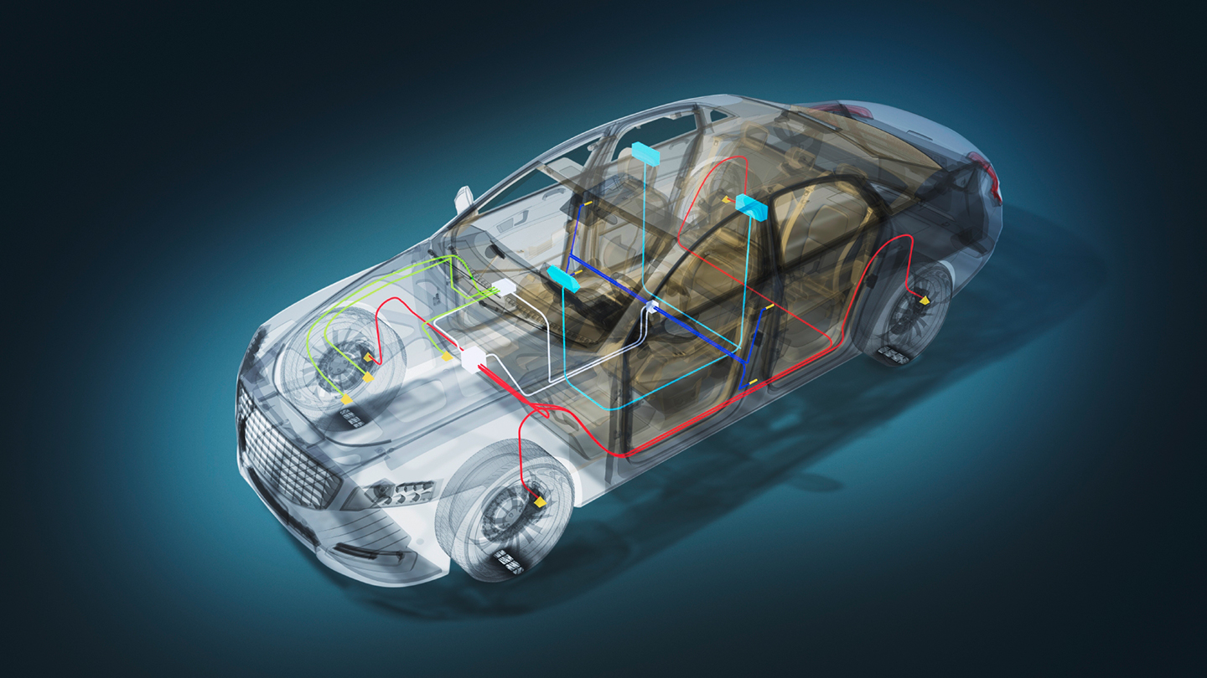
Controller Area Network
FOR BRAKE SYSTEM IN VEHICLES

Slide 2
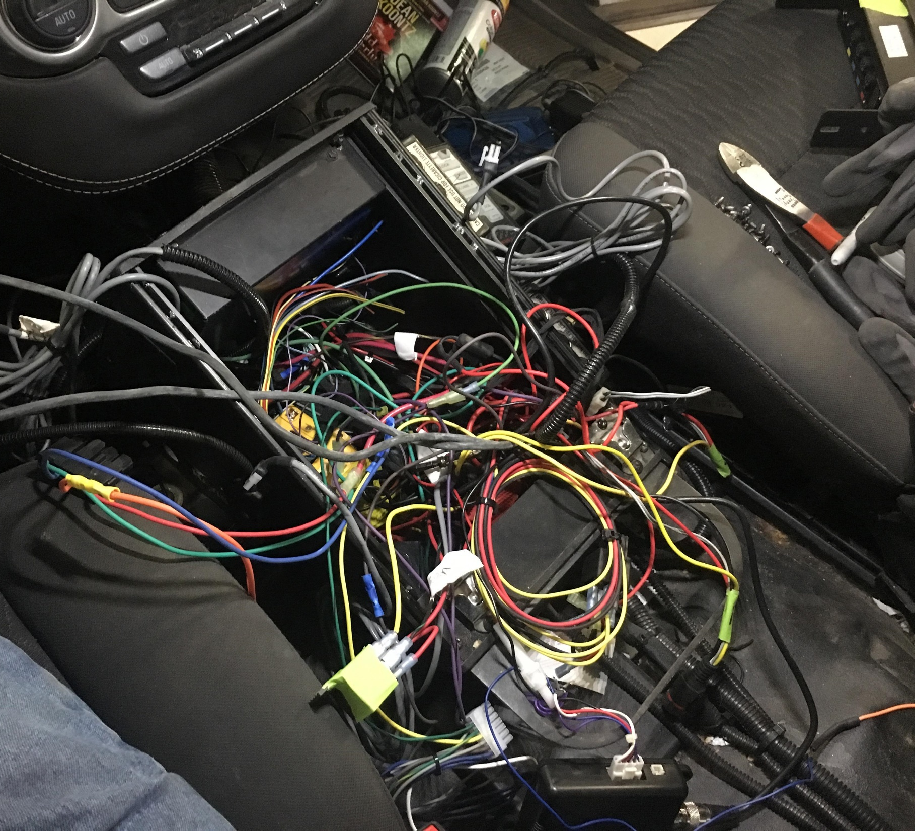

Motivation
Problem in communication between car component​
Bus (number of wires)​
Complicated​
Pervious solution : I2C didn’t reliable ​
Didn’t support for long distance ​
Unstable​
Work at low speed for long distance​
Critical Scenario : Emergency brake
2. Zafirul

Slide 3
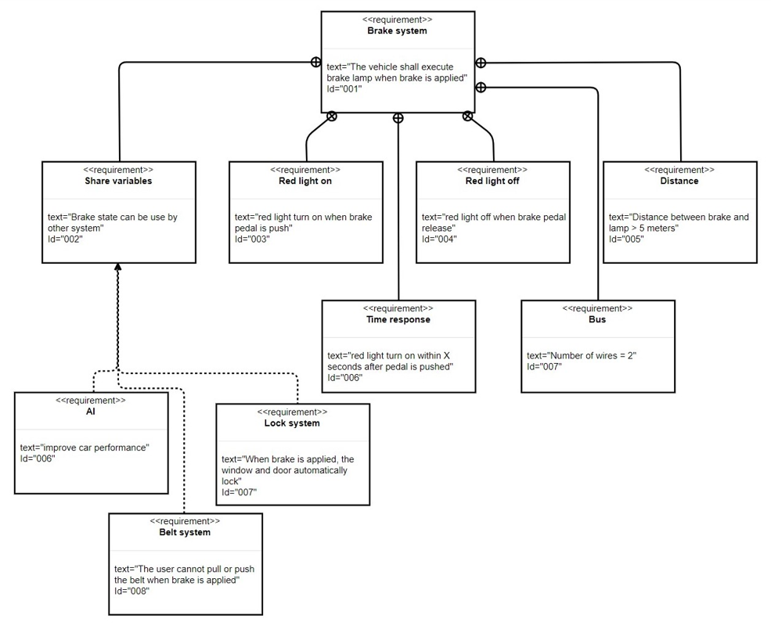

New Requirement

Slide 4
Solution : CAN
Controller Area Network (CAN) features that can solve the problem​
Highly integrated system using serial bus and communication protocol to connect intelligent devices for real time control application

Slide 5
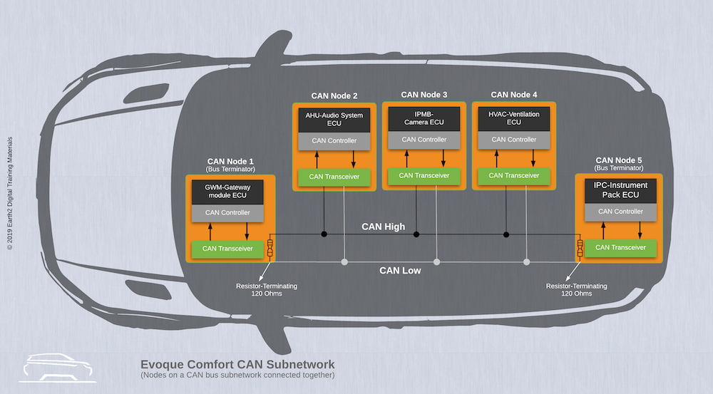

Slide 6
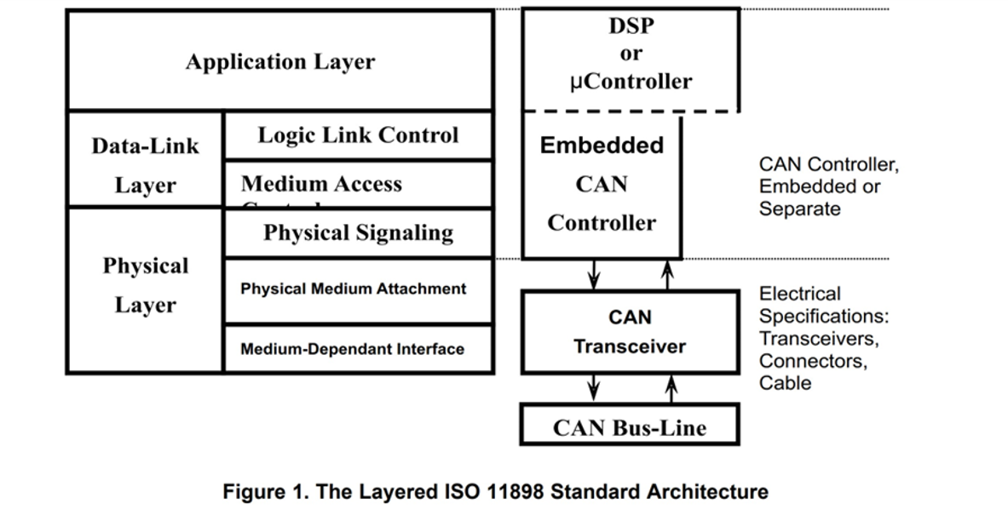
How does it work?​​

Slide 7

CAN message​
Arbitration​
Message type​
Valid frame​
Error checking and fault confinement

Slide 8

Approach
Model chosen scenario
Model solution for implementation
Use model to implement the software and hardware​

Slide 9
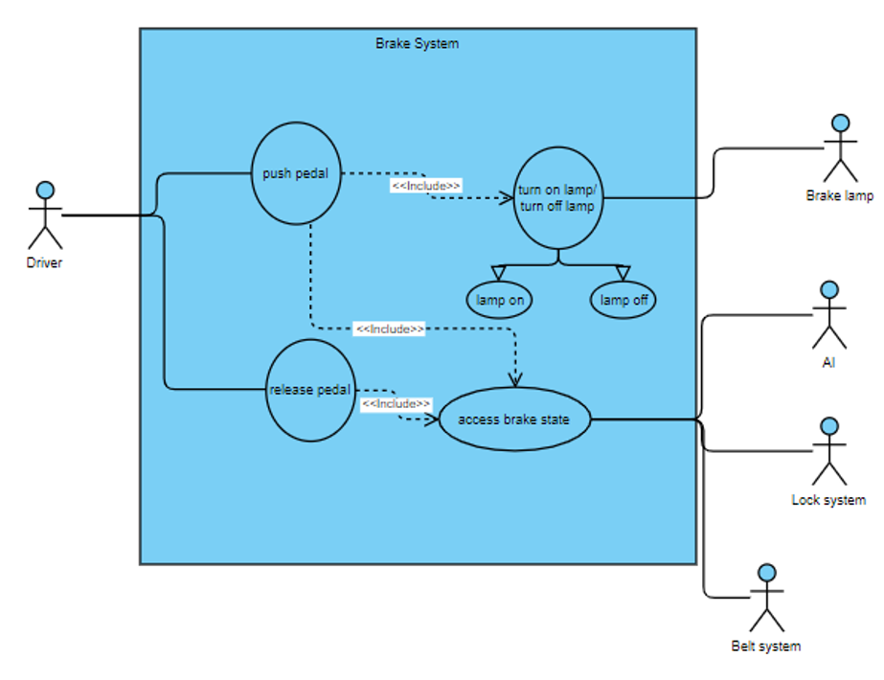
Use Case

Slide 10
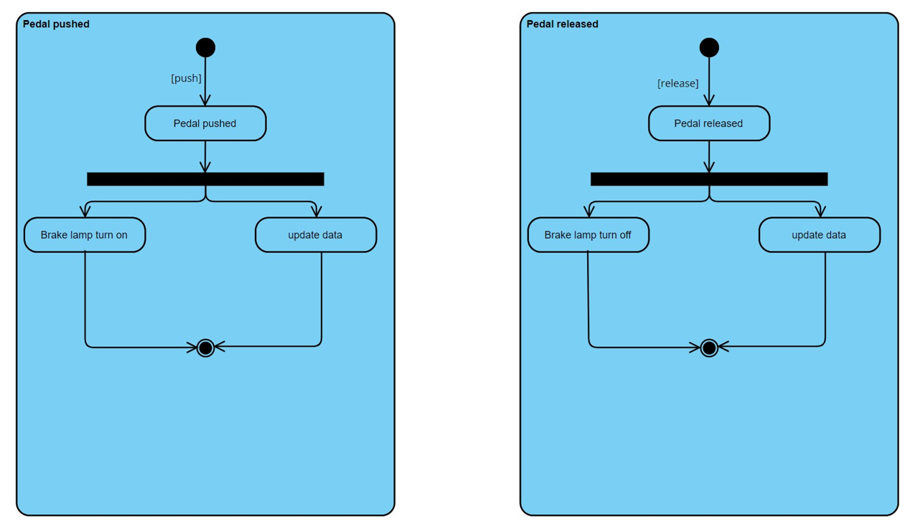
Activity

Slide 11
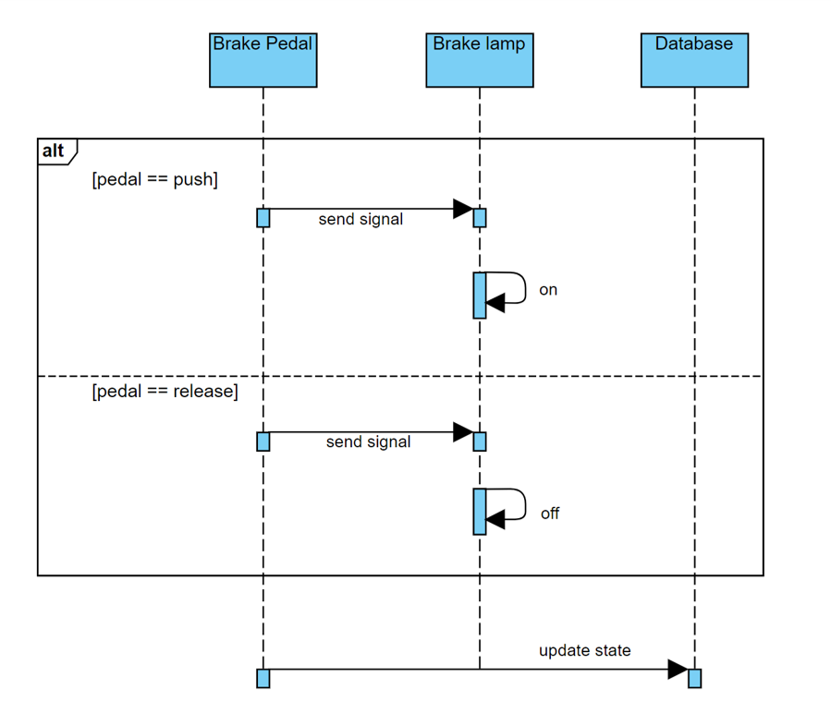
Sequence

Slide 12
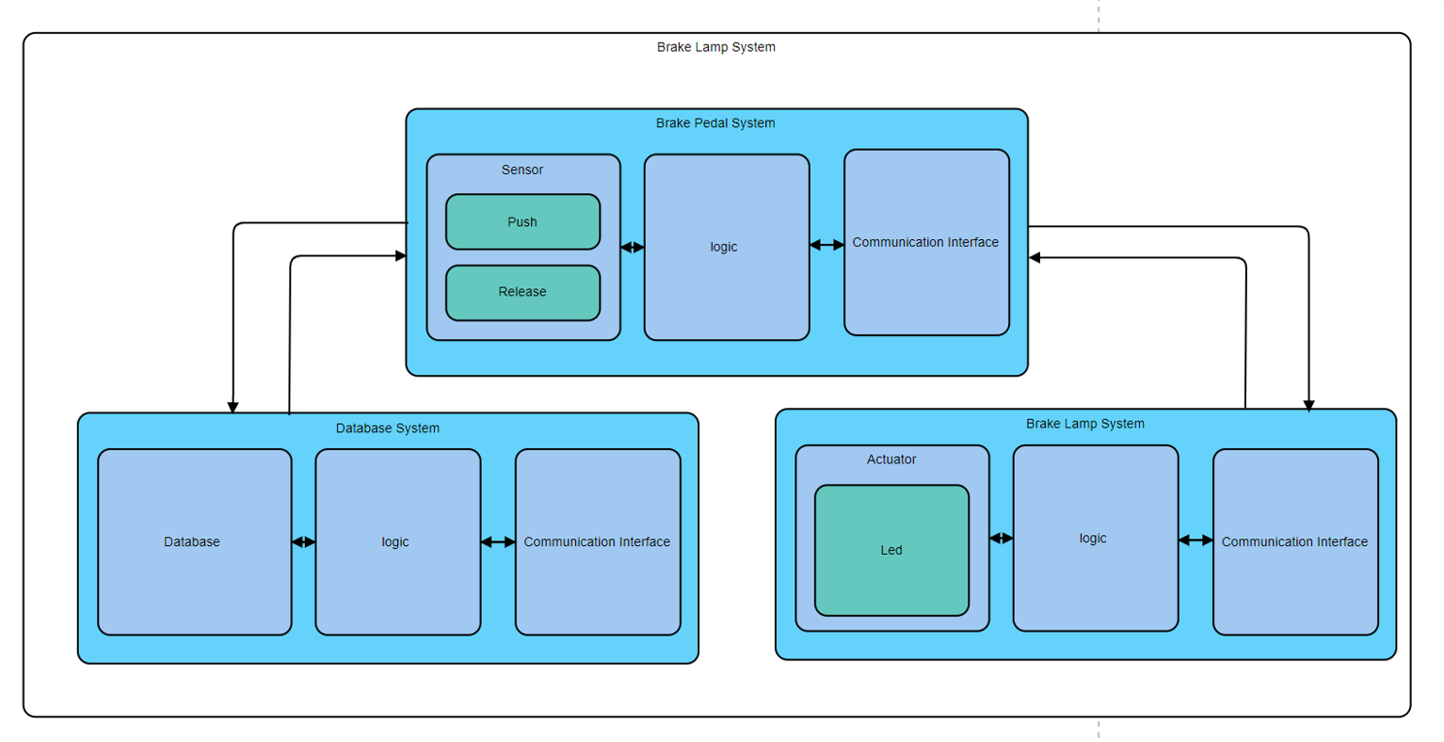
Architecture

Slide 13
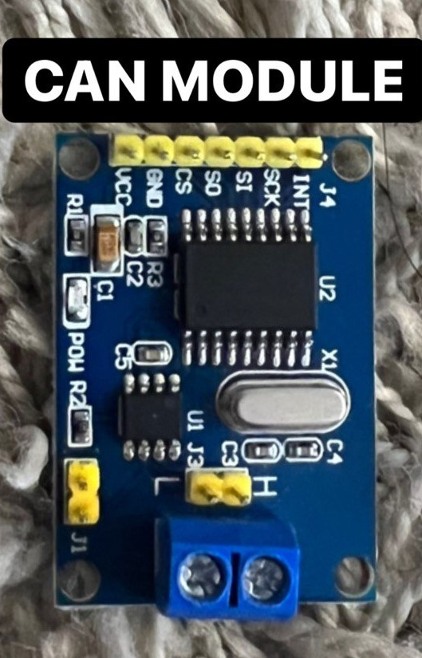
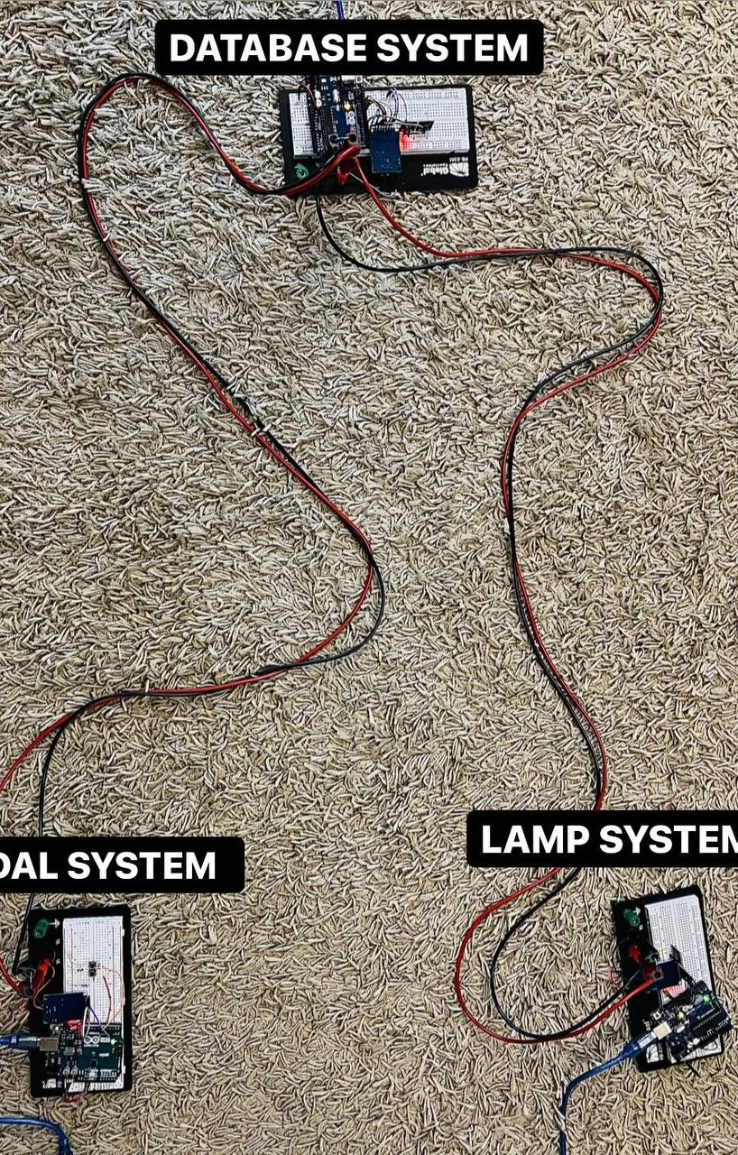
Implementation
3 car components (Arduino with CAN module)​
Brake pedal ​: button
Brake Lamp​ : led
Database​ : Arduino memory
1 bus ​
Protocol : CAN​
Length : 5 meter​
Number of wire : 2

Slide 14
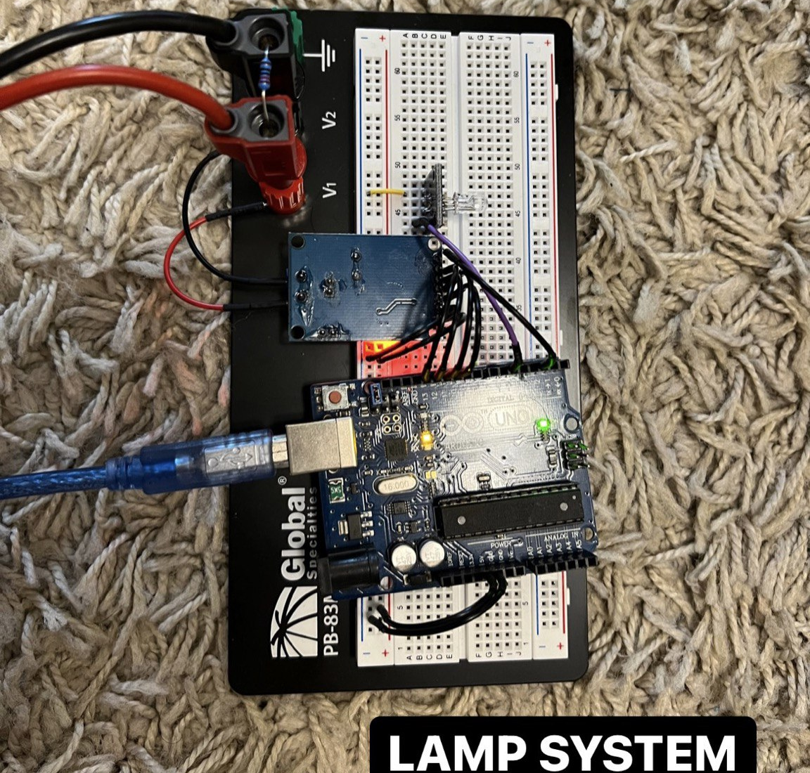
Lamp System

Slide 15
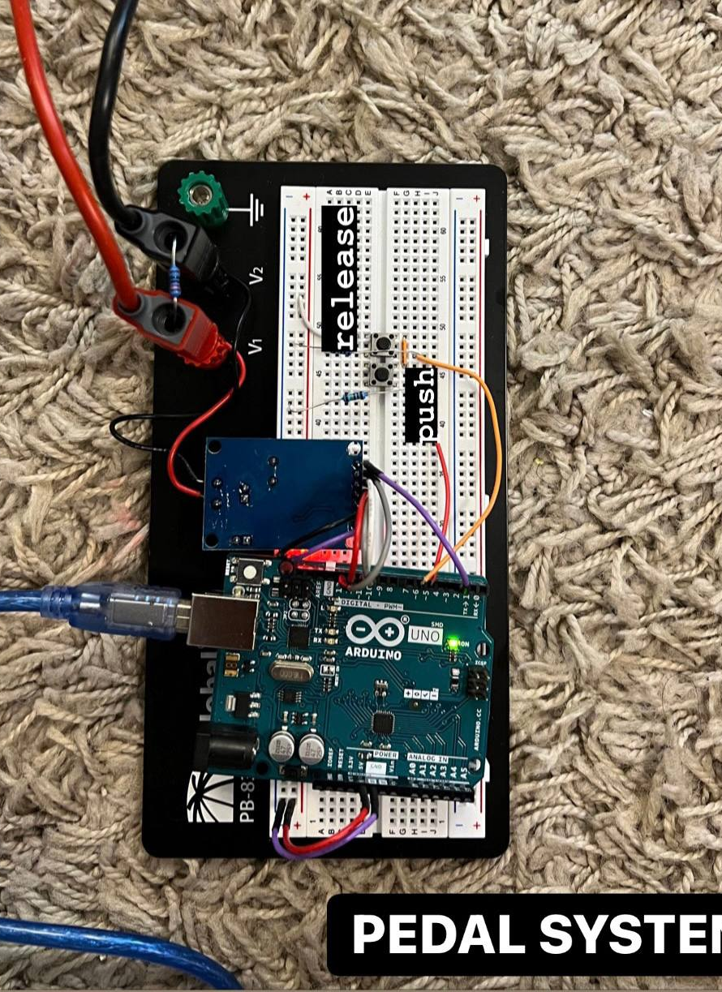
Pedal System

Slide 16
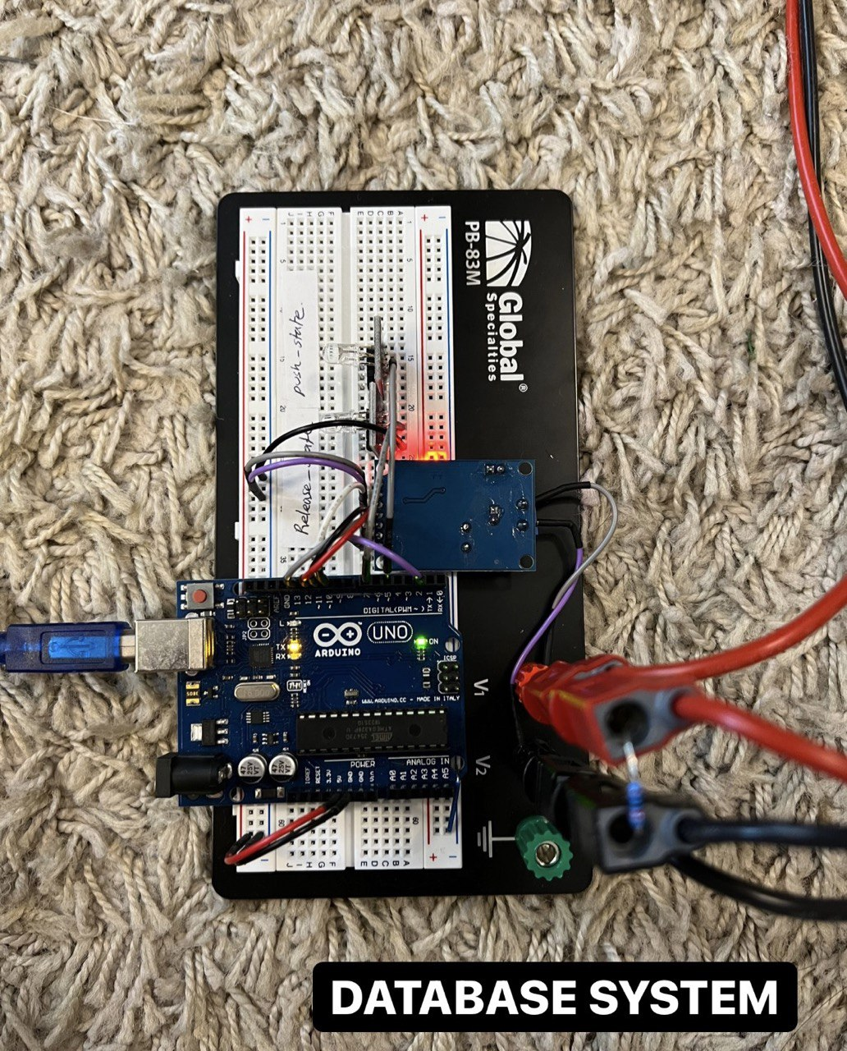
Database Server

Slide 17

Thank You

Slide 18
Reference :
S. Corrigan, “Introduction to the Controller Area Network (CAN) (rev. B),” Introduction to the Controller Area Network (CAN), Aug-2002. [Online]. Available: https://www.ti.com/lit/an/sloa101b/sloa101b.pdf. [Accessed: 16-May-2022].

